Slide 1
Lecture 09
Gaussian Mixture Model and Expectation-Maximization
Lin ZHANG, PhD
School of Software Engineering Tongji University
Fall 2021

Slide 2
Outline
Maximum Likelihood
Expectation-Maximization (EM)
EM for Gaussian Mixture Model (GMM)

Slide 3
Maximum Likelihood
Suppose that we have a density function , where is the set of parameters.
We also have a data set X, supposedly drawn from this distribution and satisfy the i.i.d. property,
Then, can be estimated by,
likelihood
(1)
Equivalently,
(2)
Log-likelihood
We use P to denote the likelihood of a group of data, and p to denote the PDF or the likelihood of a single data point

Slide 4
Maximum Likelihood
If has a simple form (such as 1D Gaussian), can be easily worked out
Example:
is a 1-D Gaussian
The observation dataset comprises a set of n scalars,
Then we have,
By solving,

Slide 5
Maximum Likelihood
However, when has a complex form (actually in most cases), cannot be worked out analytically.
For example, when the data is modeled as a Gaussian mixture model,
(3)
where N is a Gaussian distribution in the d-dimensional space,
(4)
Note that: is the covariance matrix and thus is semi-definite (and of course symmetric)
Expectation-Maximization is a general framework to iteratively estimate the parameters of models

Slide 6
Outline
Maximum Likelihood
Expectation-Maximization (EM)
EM for Gaussian Mixture Model (GMM)

Slide 7
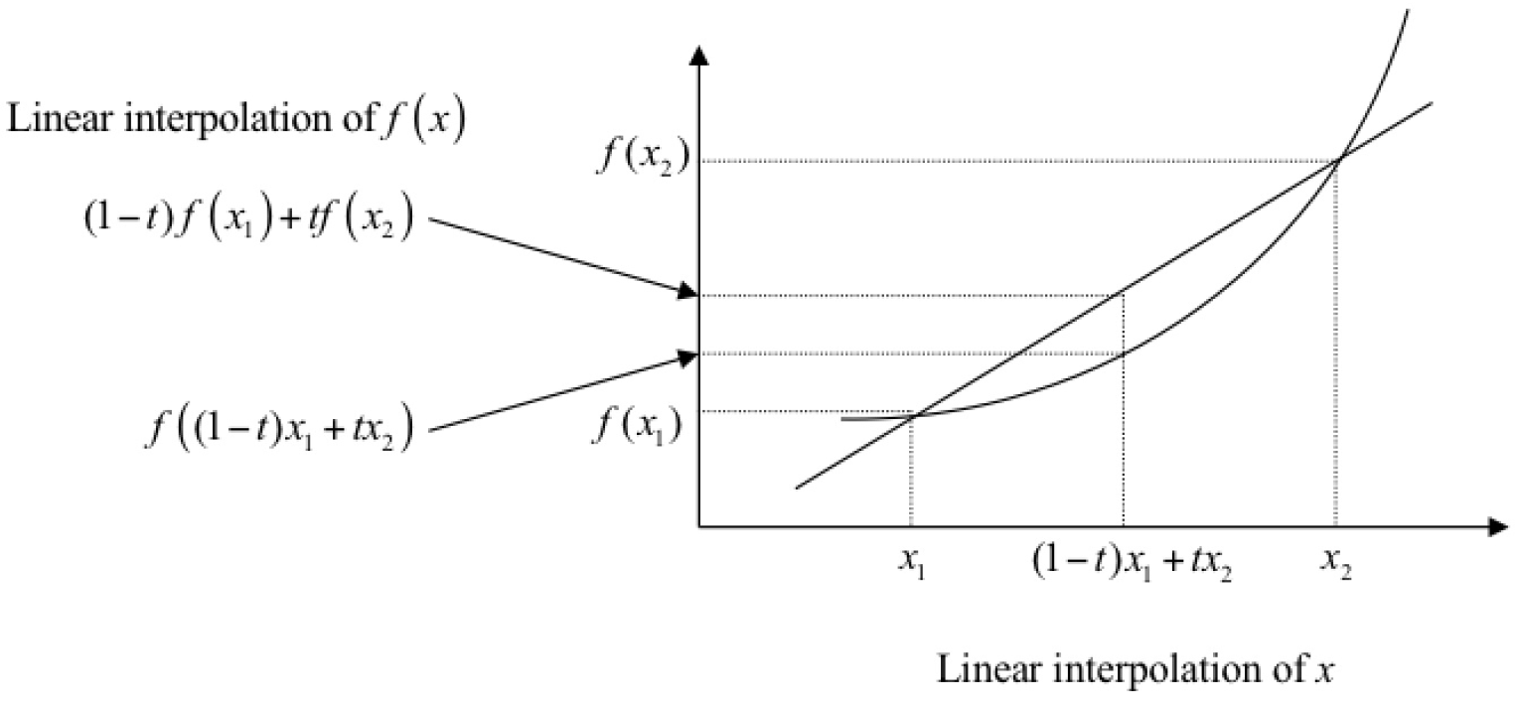
Pre-requisite
Jensen’s inequality
Suppose that f(x) is a convex function

Slide 8
Pre-requisite
Jensen’s inequality
Its basic form
Convex combinations of more than two points:
f is convex,
f is convex,
we have,
we have,

Slide 9
Pre-requisite
Jensen’s inequality
In probability form
(5)
Function of the expectation (of the random variable)
Expectation of the function

Slide 10
Expectation-Maximization
In statistics, an expectation–maximization (EM) algorithm is an iterative method to find maximum likelihood or maximum a posteriori (MAP) estimates of parameters in statistical models, where the model depends on unobserved latent variables
The EM iteration alternates between performing an expectation (E) step, which creates a function for the expectation of the log-likelihood evaluated using the current estimate for the parameters, and a maximization (M) step, which computes parameters maximizing the expected log-likelihood found on the E step. These parameter-estimates are then used to determine the distribution of the latent variables in the next E step

Slide 11
Expectation-Maximization
Our goal,
Make use of EM to solve this problem:
The trick is to assume some “latent” variable Z to the model
Such that we can generate a series of
For each iteration of the EM algorithm, we perform,
(6)
where is the set of observed data and each one is independently drawn from a certain distribution , and is the set of latent variables and each z_{i} is a random variable whose PDF can be represented as p(z)

Slide 12
Expectation-Maximization
For each iteration of the EM algorithm, we perform,
We need to prove such an iteration works, i.e.,
(7)
How to prove (7)?

Slide 13
Expectation-Maximization
Then we have,
Compute the expectation of the above equation with the PDF , then

Slide 14
Expectation-Maximization
For iteration g+1,
If we can prove,
if does not change, i.g. ,
then,
if updates to ,
>=
Then, we must have
According to (6)

Slide 15
Expectation-Maximization
Jensen Inequality (see next page)
That is,

Slide 16
Expectation-Maximization
More on Jensen inequality
In our case,
Suppose t is the composite function of z, t(z),
Then,

Slide 17
Expectation-Maximization
From the above proof, EM algorithm can converge and can work.
For each iteration of the EM algorithm, we perform,
(Eq. 6)
M-step: Maximization
E-step: get expectation
How to perform E and M step for a given problem?
Next, let’s see how to perform EM for GMM

Slide 18
Outline
Maximum Likelihood
Expectation-Maximization (EM)
EM for Gaussian Mixture Model (GMM)

Slide 19
Gaussian Mixture Model
GMM is a commonly used tool to model the distribution of data and has many potential applications, such as foreground detection, acoustic model
Probability density function of the GMM,

Slide 20
Gaussian Mixture Model
Let’s get a feel about GMM
% first distribution is centered at (0,0), second at (3,3)
mu = [0 0; 3 3];
% covariance of first is identity matrix, second diagonal
sigma = cat(3, eye(2), [5 0; 0 1]);
% using equal priors
p = [0.5; 0.5];
% build GMM
gmm = gmdistribution(mu, sigma, p);
% 2D projection
ezcontourf(@(x,y) pdf(gmm,[x y]));
% view PDF surface
ezsurfc(@(x,y) pdf(gmm,[x y]));

Slide 21
Gaussian Mixture Model
Remember the log-likelihood (Eq. 2),
when is GMM
Now we need to estimate from X using EM

Slide 22
EM for Gaussian Mixture Model
(Eq. 6)
It requires that latent variables should not change the marginal distribution of the data
Let’s verify
For GMM, Z represents which Gaussian the data X come from; i.g., for each pair
, z_{i} indicates the index of Gaussian for x_{i}. So,
,
,
, does not change the marginal distribution of x_{i}

Slide 23
EM for Gaussian Mixture Model
(Eq. 6)
For GMM, ,
( will be given later)
Notes:
zi表示数据xi来自哪一个高斯，p(zi=1)就是来自第一个高斯的概率alpha1；p(zi=2)就是来自第2个高斯的概率alpha2, 所有p(zi)=alphazi

Slide 24
EM for Gaussian Mixture Model
E-step:

Slide 25
EM for Gaussian Mixture Model

Slide 26
EM for Gaussian Mixture Model
M-step:
(8)
For obtaining optimal ,
By Lagrange multiplier,

Slide 27
EM for Gaussian Mixture Model

Slide 28
EM for Gaussian Mixture Model

Slide 29
EM for Gaussian Mixture Model
M-step:
(8)
The objective actually is,

Slide 30
EM for Gaussian Mixture Model
(9)
Solving :

Slide 31
EM for Gaussian Mixture Model

Slide 32
EM for Gaussian Mixture Model
(9)
Solving :
Let , then
Then,

Slide 33
EM for Gaussian Mixture Model

Slide 34
EM for Gaussian Mixture Model
To summarize,
where,

Slide 35

Notes:
35

